Slide 1
Increasing factory sensor data outside the PLC
Comtrol Corporation

Slide 2
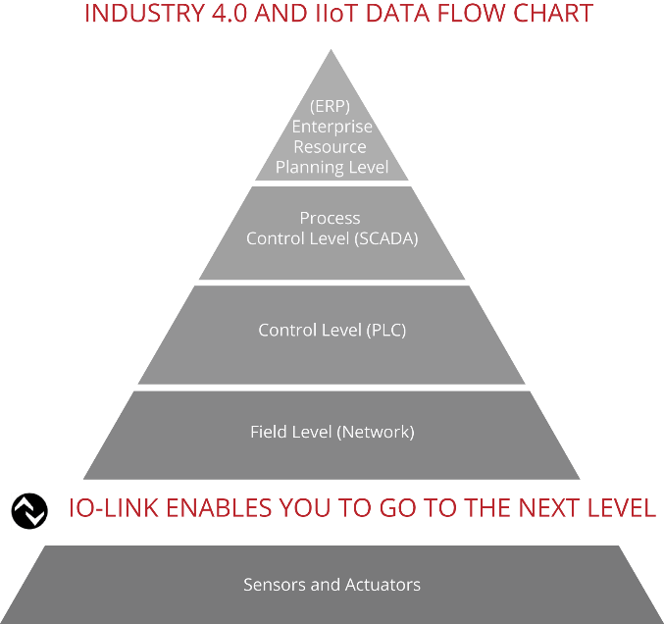
IO-Link Masters Enable Industry 4.0 and IIoT
• Complete integration into overall industrial communication systems • Easy sensor replacement • Eliminates manual parameter settings • Continuous data monitoring and status diagnostics • Increased uptime

Slide 3
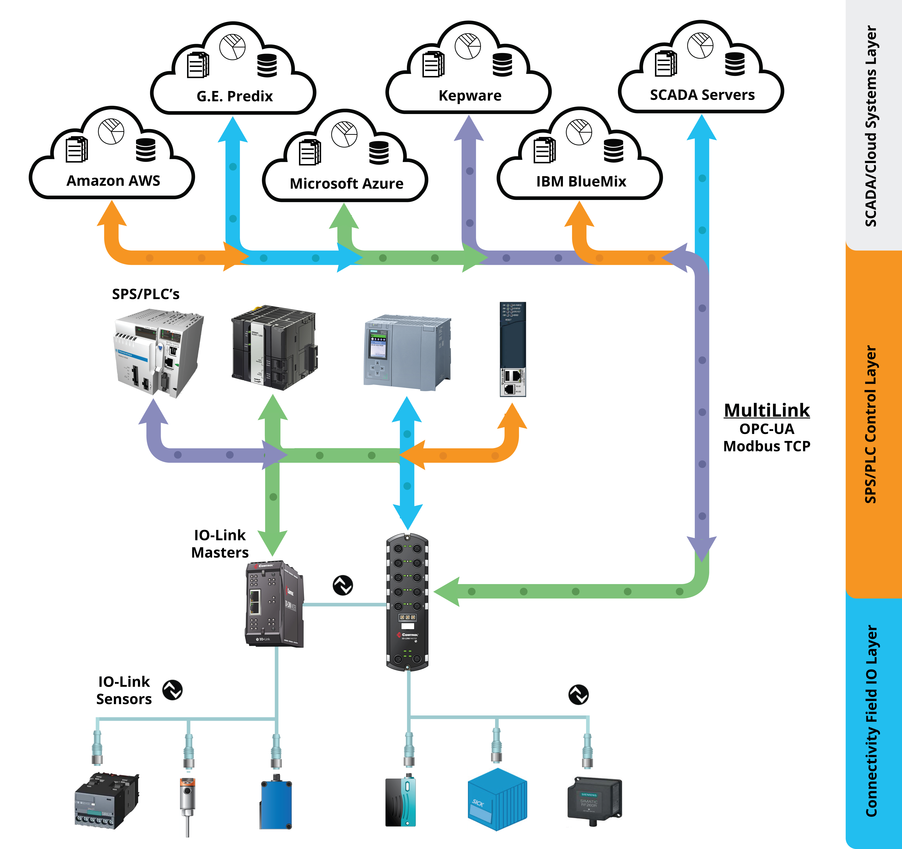
MultiLink Simultaneously Provides IO-Link Device Access to Multiple Controllers
• Provides simultaneous access to the PLC via Industrial Ethernet AND connects SCADA software via OPC-UA • Works with Multiple PLC platforms • Enables Enterprise Cloud solutions or SCADA systems for IIoT/Industrie 4.0 initiatives

Slide 4
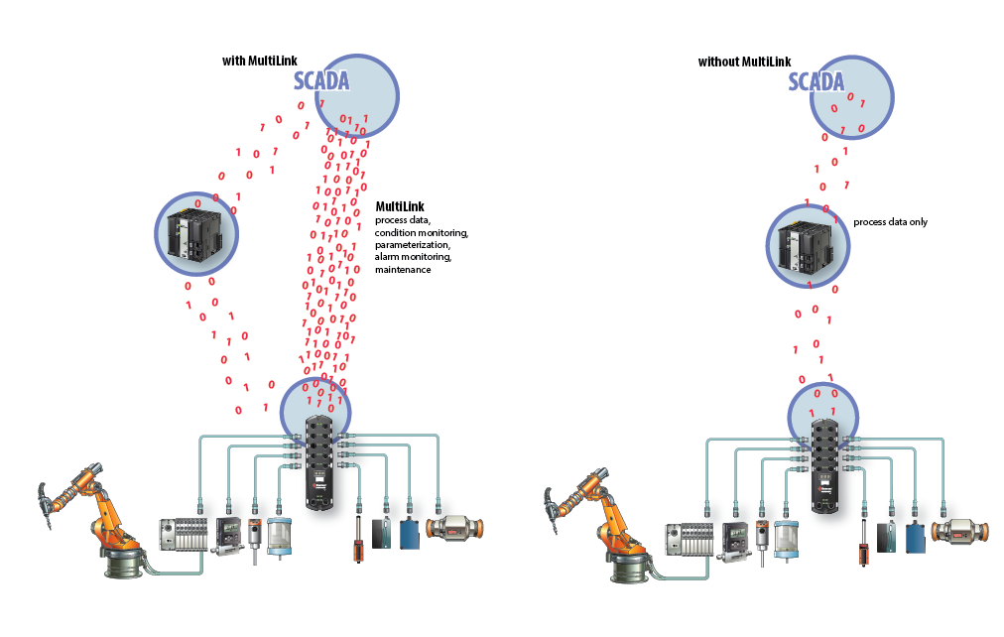
OPC UA provides simultaneous sensor data availability
• Cyclic Data - data that the sensor senses - Flow rate - Temperature - Distance • Acyclic Data - data about the sensor, what it is and how the operation is working
Pressure
Presence
Tag contents

Slide 5
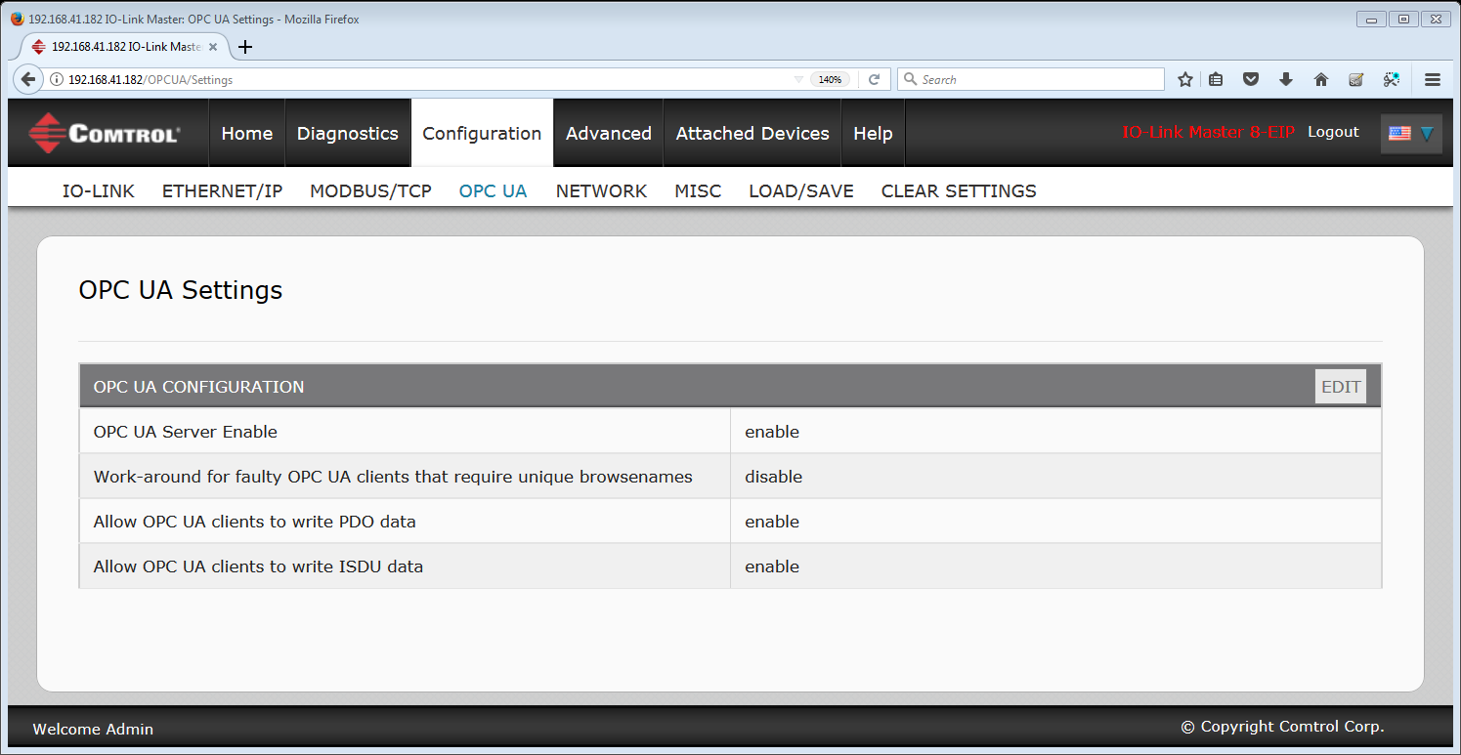
OPC UA provides simultaneous sensor data availability
Configuration Step 1

Slide 6
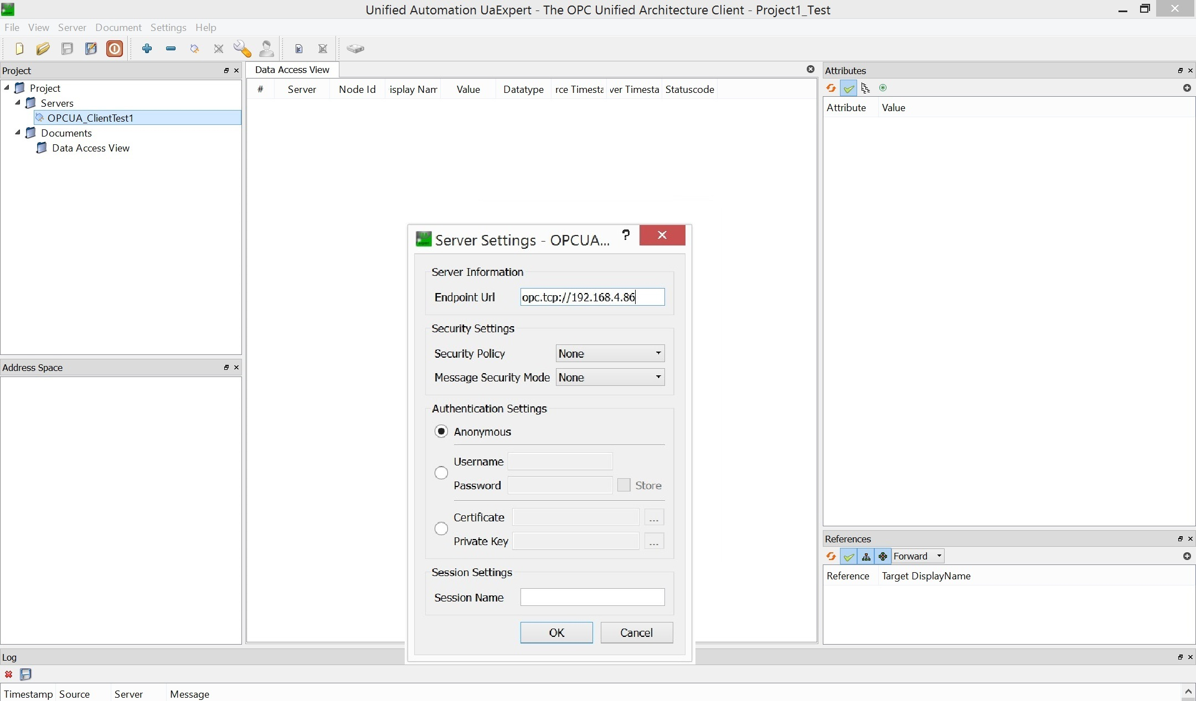
OPC UA provides simultaneous sensor data availability
Configuration Step 2

Slide 7
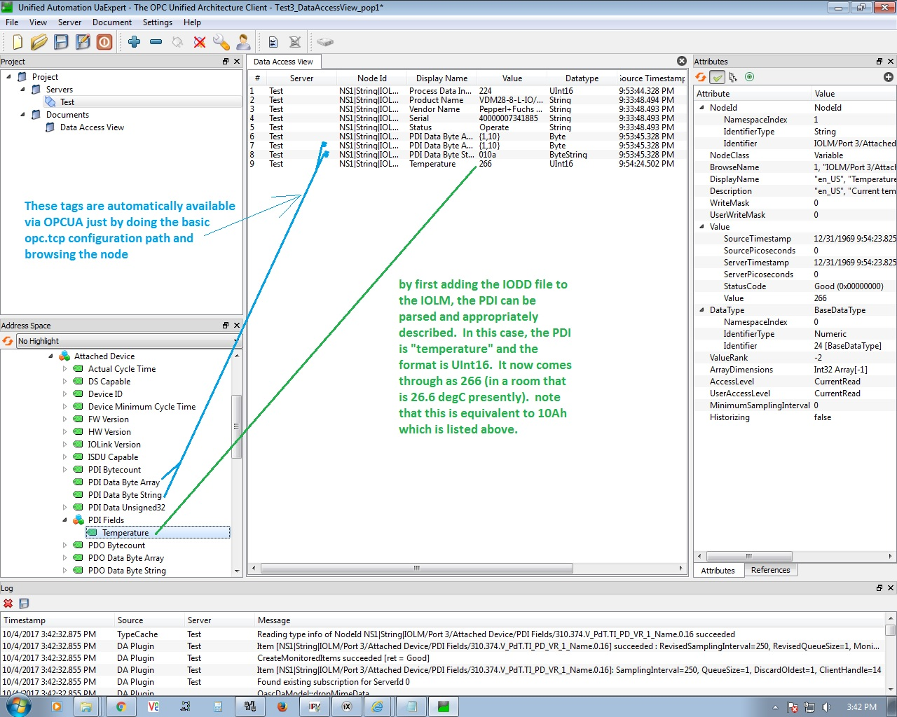
OPC UA provides simultaneous sensor data availability
• Cyclic Data -w/o IODD -with IODD

Slide 8
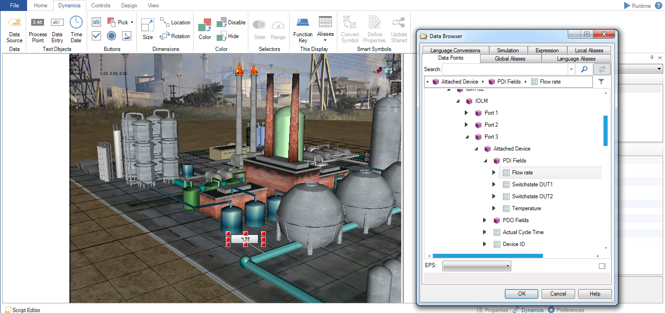
OPC UA provides simultaneous sensor data availability
• Cyclic Data -w/o IODD -with IODD

Slide 9
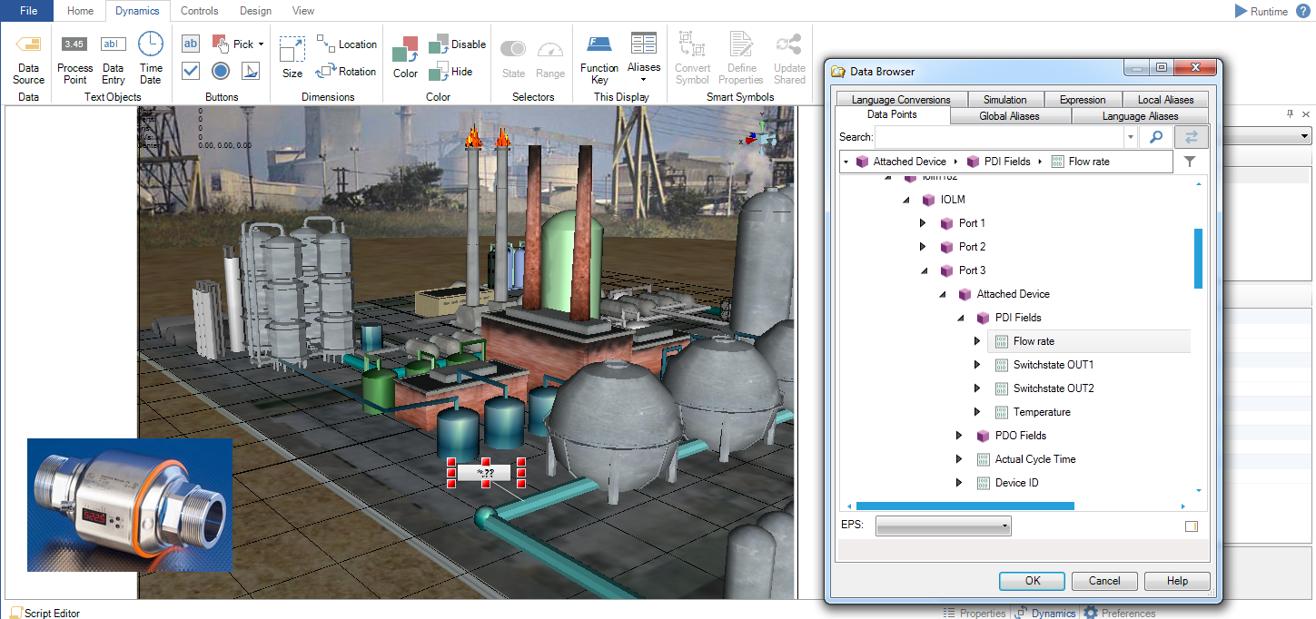
OPC UA provides simultaneous sensor data availability
• Cyclic Data -w/o IODD -with IODD

Slide 10
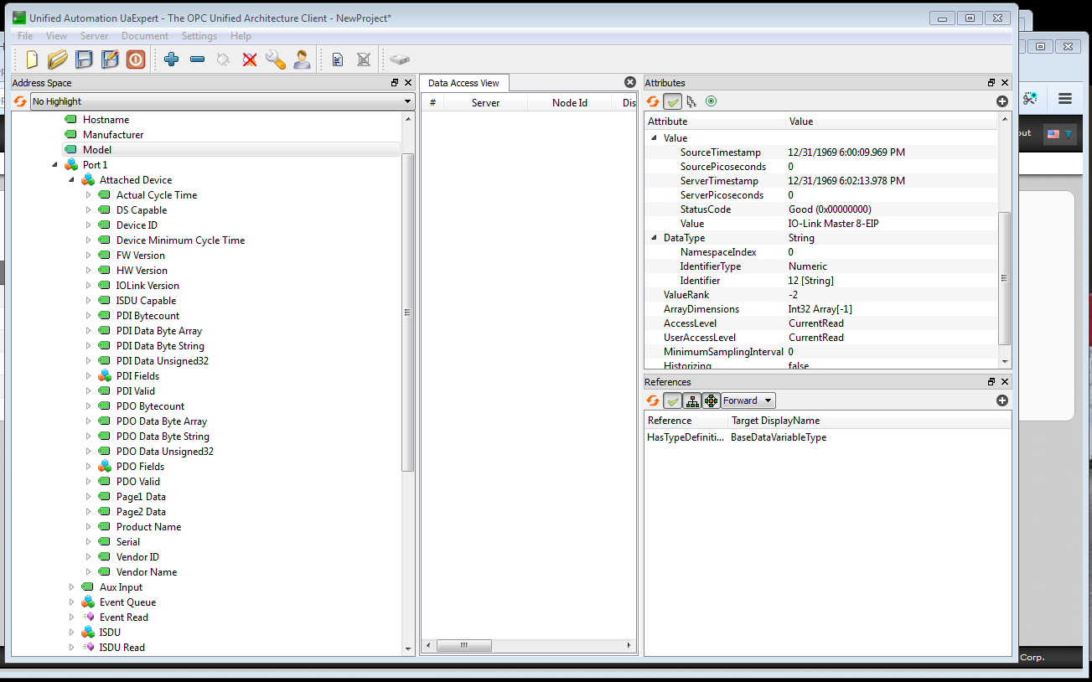
OPC UA provides simultaneous sensor data availability
• Acyclic Data - data about the device including identifying information, present status, and others

Slide 11
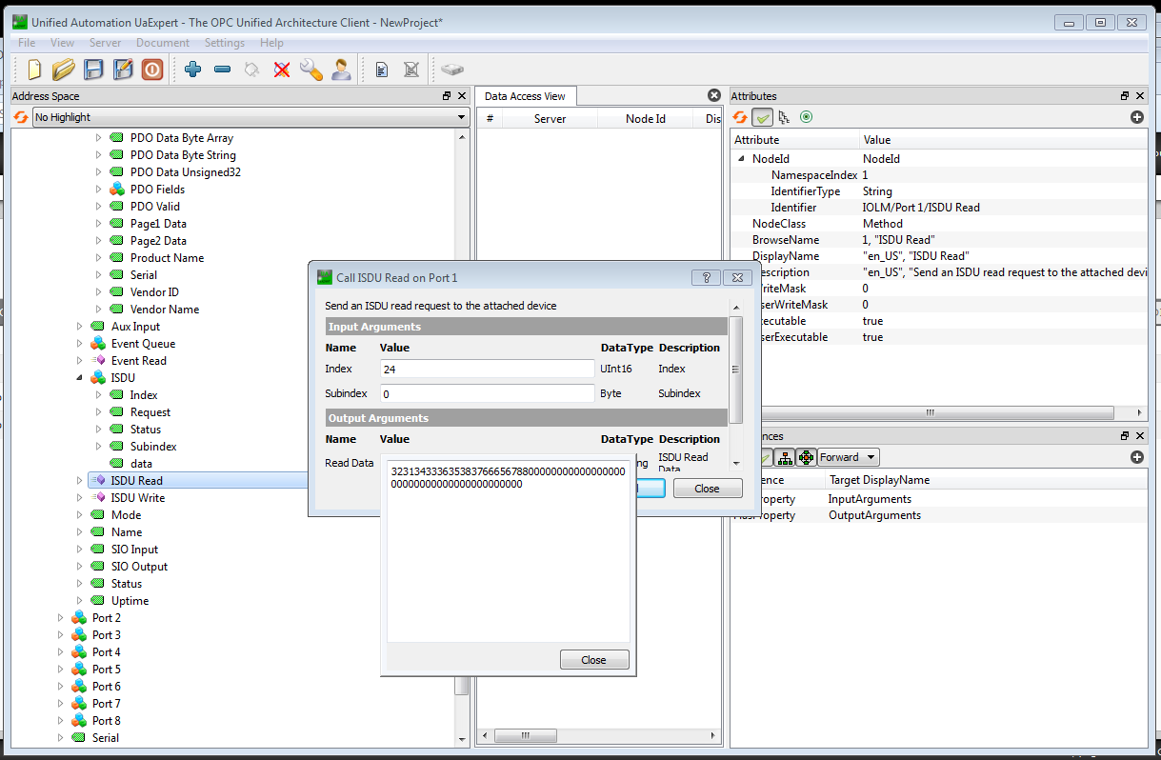
OPC UA provides simultaneous sensor data availability
• Acyclic Data – editing R/W ISDUs via OPCUA also supported

Slide 12
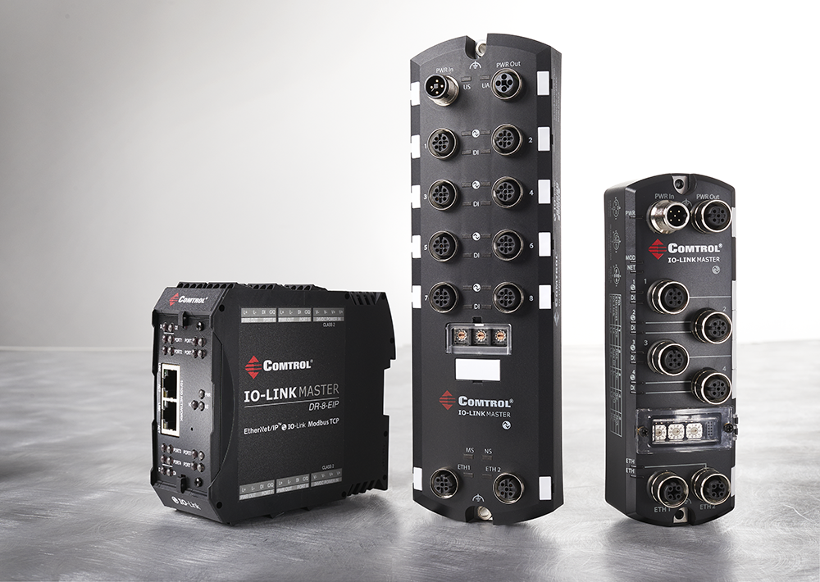
A Variety of Form Factors for OPCUA Support of IOL
• Full visibility and communication via IO-Link, also PD via Analog and standard DIO Sensors and Actuators
• Comtrol IO-Link Masters provide IP-65/67 and IP20 remote control of sensors via OPC UA
• Embedded OPC UA Server
• Future MS Azure IoT Gateway
Sensor data visibility and health-monitoring = factory situational awareness

Slide 13
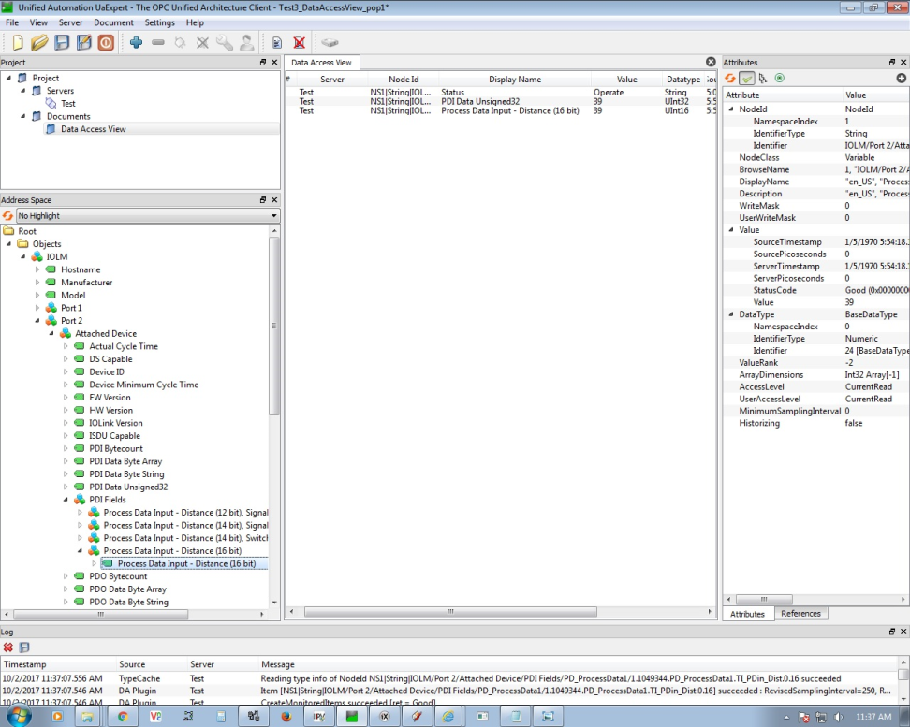
OPC UA and Factory sensor data transport to Unified Automation
• OPC UA provides unfiltered cyclic and acyclic data communication from Comtrol sensor master to software systems • Iconics, Unified Automation and Ignition are popular supported systems • Sensor / Master data will be populated with IP Address • Data can be immediately shown in software systems

Slide 14
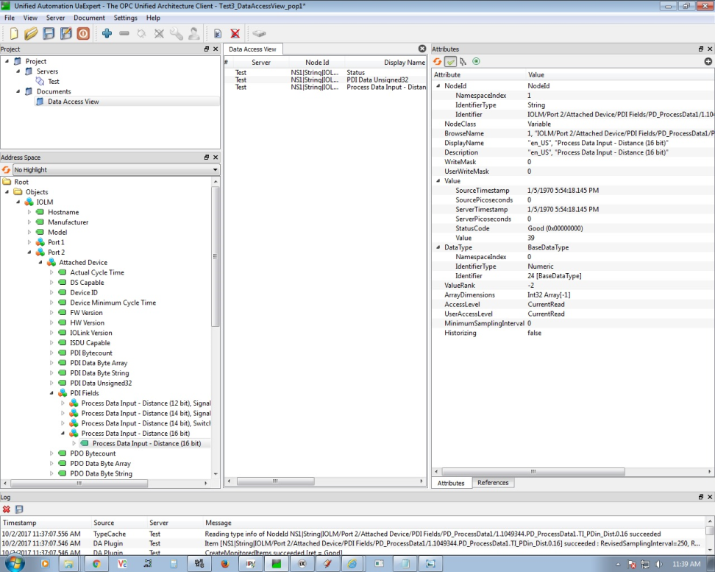
Data visibility provides condition monitoring for every sensor
• Sensor data tags show source data time stamp, data type, value for any sensor or actuator • Information such as contamination feedback, version control etc. gives you information about your factory’s performance and efficiency, showing which machines are running well and to what extent

Slide 15
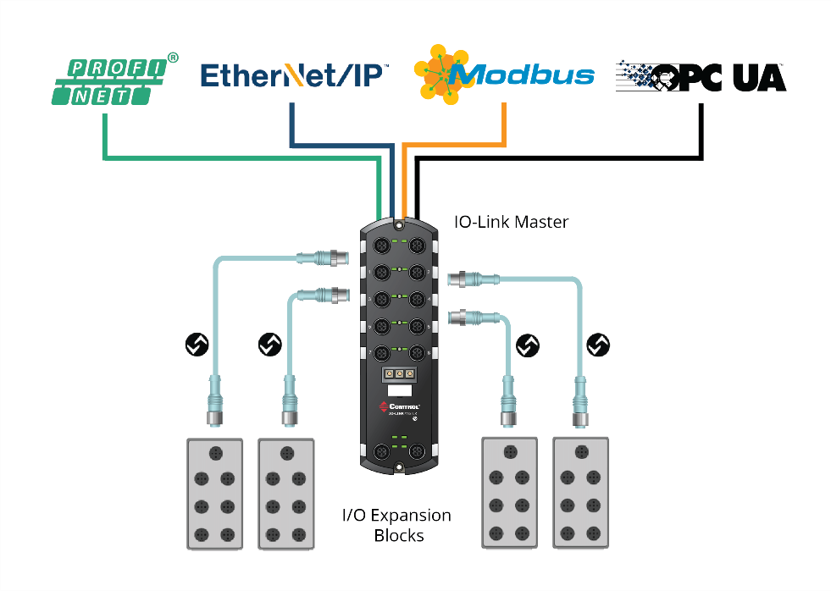
Comtrol’s IO-Link Master Gateways
• Full support of IO-Link v1.0 and v1.1 sensors, actuators, and other digital IO devices • Reduce maintenance and cabling costs • Reduce PLC programming time or in some cases eliminate the need to program the PLC altogether • System integration and interoperability for HMI/SCADA and process controllers • Sensor replacement with saved configuration in seconds

Slide 16
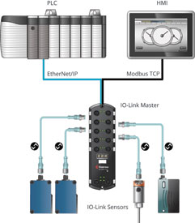
IO-Link Master Gateway EtherNet/IP
The IO-Link Master EtherNet/IP™ (EIP) series combines the benefits of the IO-Link standard with EtherNet/IP™ and Modbus TCP protocols. You can easily integrate the IO-Link Master into an industrial network with existing and new EtherNet/IP™ and Modbus TCP installations using our powerful web interface.

Slide 17
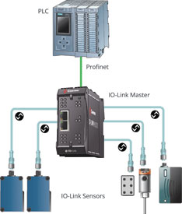
IO-Link Master Gateway PROFINET IO
The IO-Link Master PROFINET (PNIO) series combines the benefits of the IO-Link standard with the PROFINET protocol. Integrate the IO-Link Master into an industrial network with existing and new PROFINET IO installations using our powerful web interface and TIA Portal

Slide 18
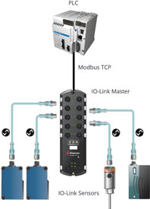
IO-Link Master Gateway Modbus TCP
The IO-Link Master Modbus TCP combines the benefits of the IO-Link standard with the Modbus TCP protocol. Integrate the IO-Link Master into an industrial network with existing and new Modbus TCP installations using our powerful web interface.

Slide 19
Pressure Monitoring in Welding Application
Using Comtrol IO-Link Master, they are sending sensor data using: Modbus TCP to Controller OPC UA to Ignition OPC Client Azure IoT Hub to Microsoft Azure Monitoring, and running historians on pressures on a welding machine

Slide 20
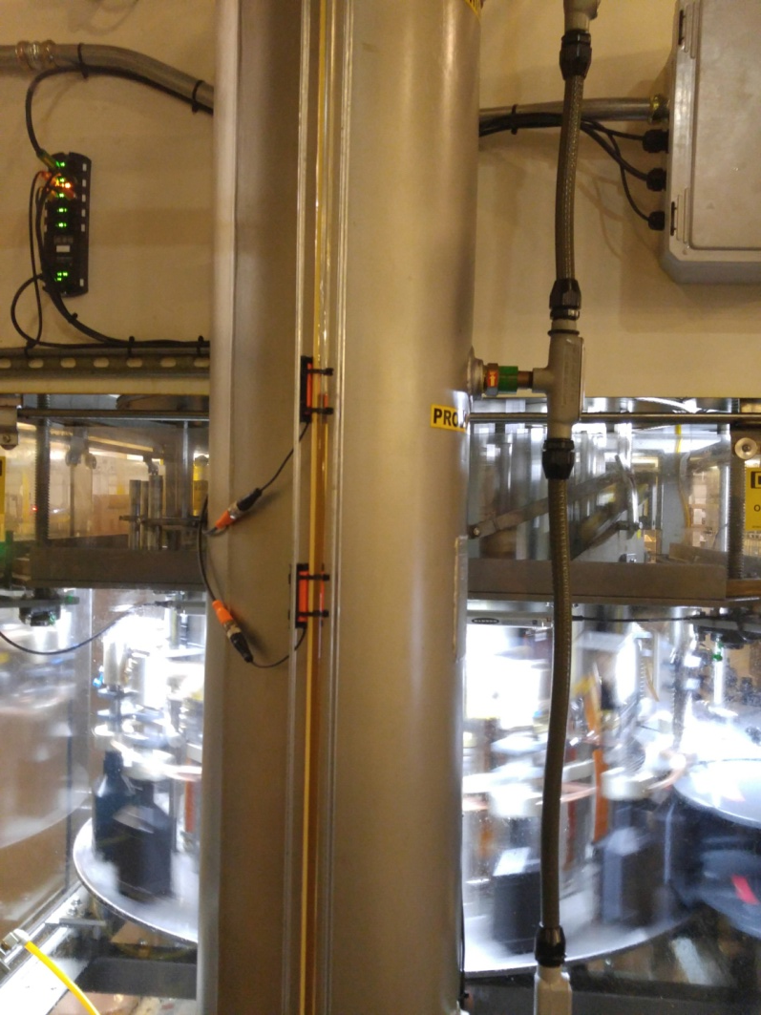
Pressure Monitoring in Welding Application
Comtrol’s IOLM DR-8 was installed to connected flow and pressure sensors
Monitoring conditions of pipes leading into holding tanks
On bottling lines they installed the IOLM 8-port IP67 blocks to connect flow, capacitive and pressure sensors
These sensors were monitoring oil flow into the bottling machine
The machine is fed empty bottles on a conveyor, fills them, then spins them out to the next process
They have data storage activated on v1.1 sensors to allow for quick replacement if a sensor failed or was damaged

Slide 21
Thank you

